Slide 1
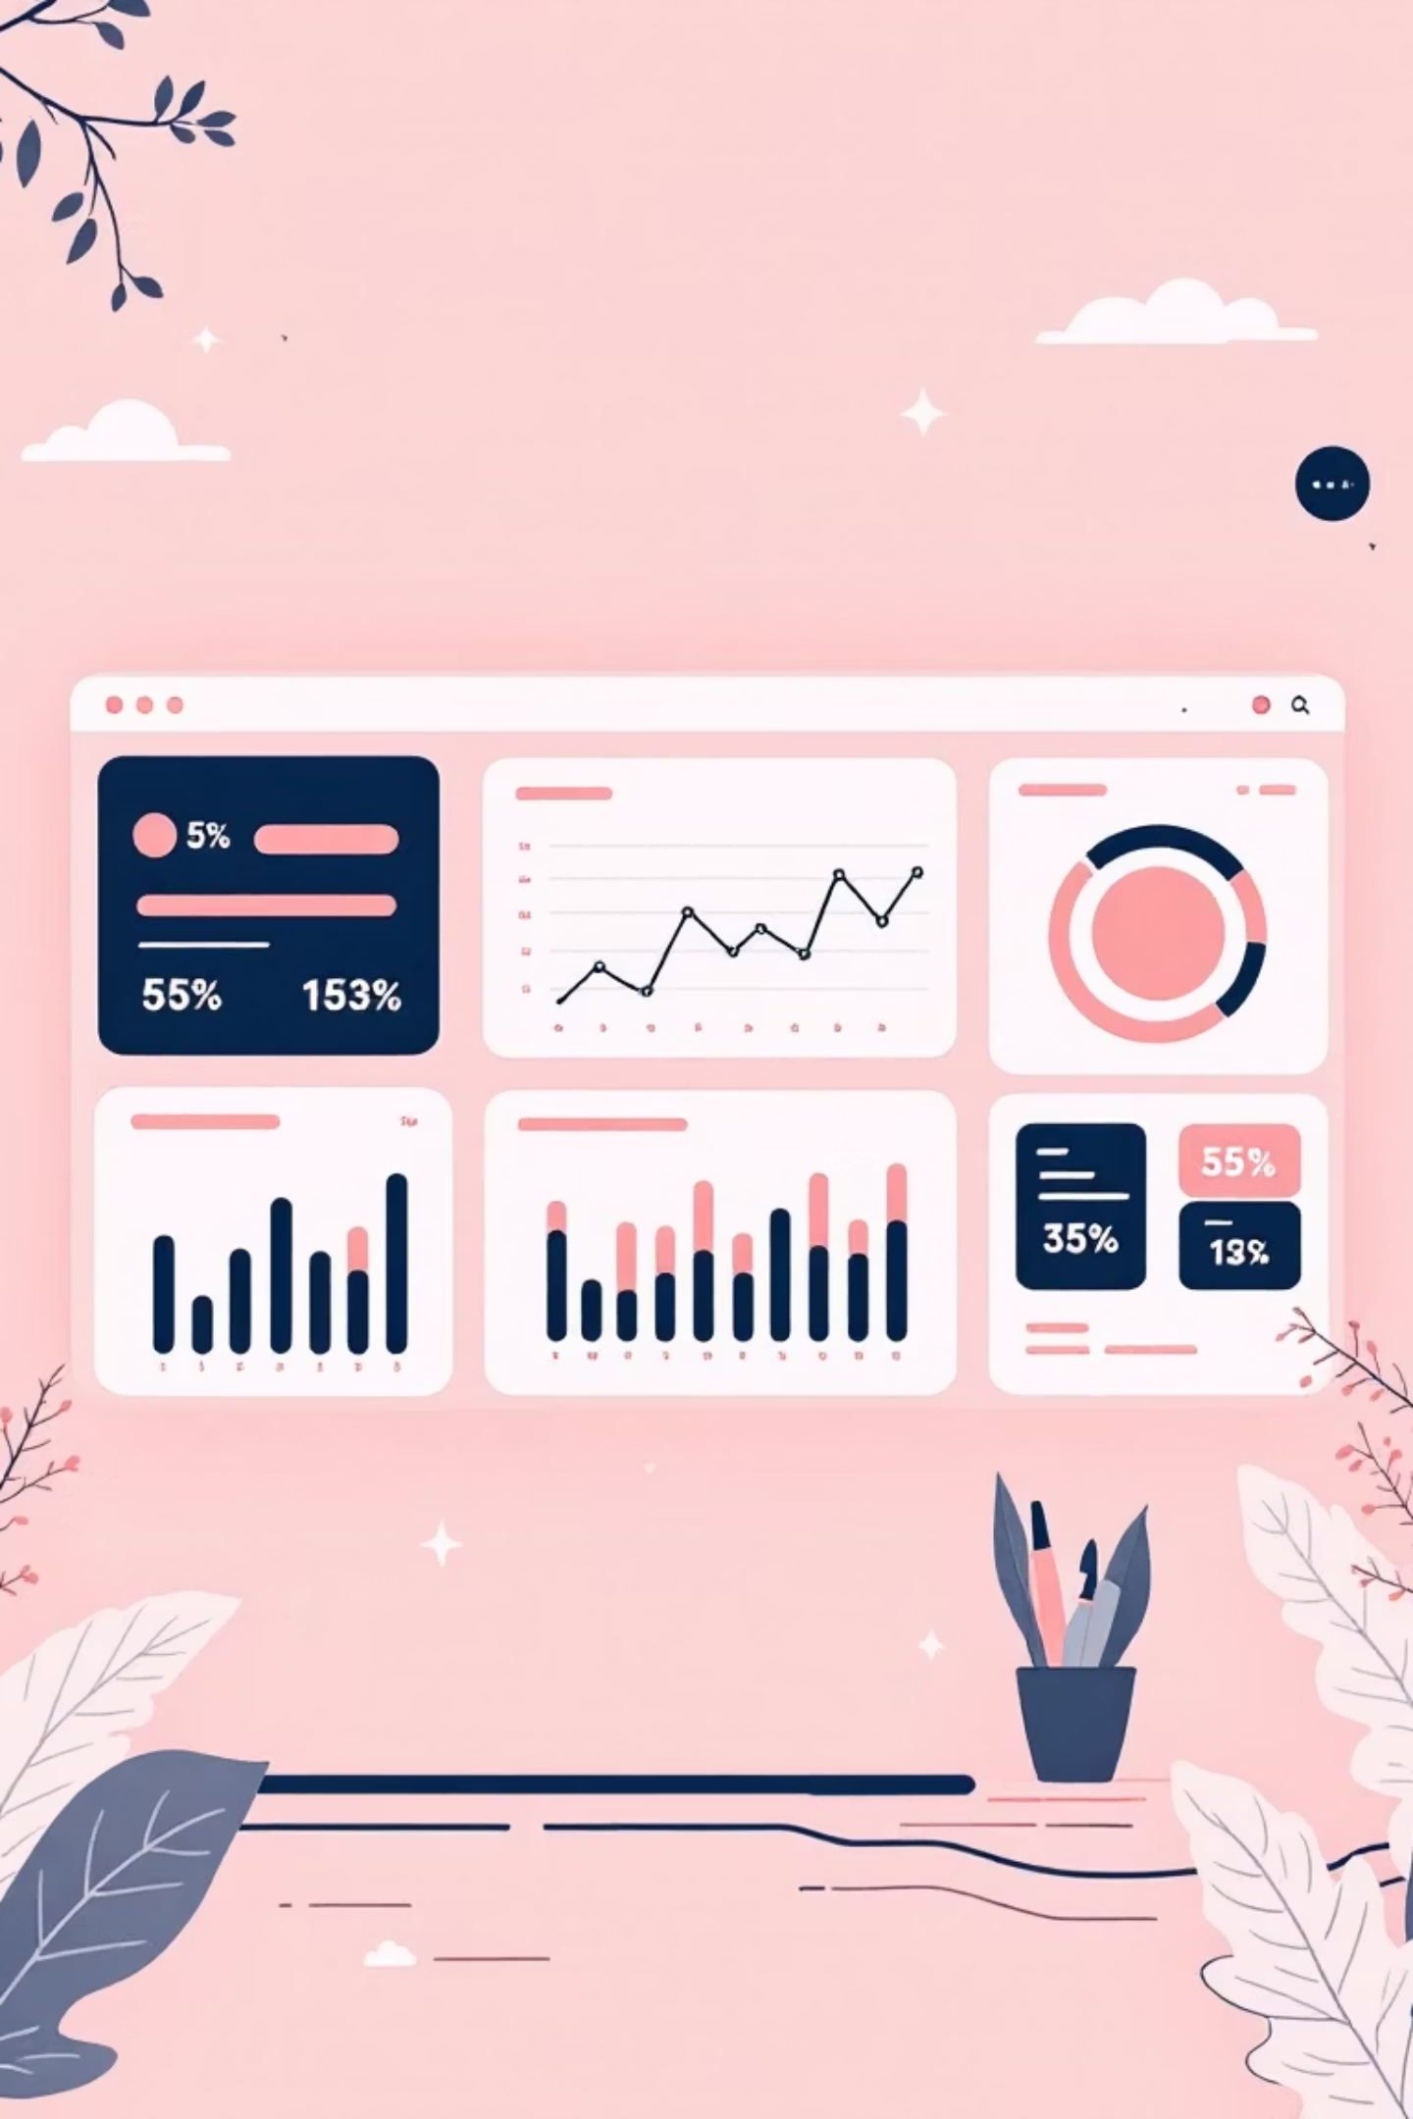
Customer Shopping Behavior Analysis
Uncovering insights from 3,900 purchases to drive strategic business decisions

Slide 2

OVERVIEW
Project Scope
Dataset Size
Focus Areas
3,900 transactions analyzed
Spending patterns
18 key features tracked
Customer segments
Product preferences
Goal
Guide strategic business decisions through data-driven insights

Slide 3


DATA
Dataset Overview
Customer Demographics
Shopping Behavior
Age, Gender, Location
Discount Applied
Subscription Status
Previous Purchases
Purchase Details
Review Rating
Shipping Type
Item, Category, Amount
Season, Size, Color
Data Quality
37 missing values in Review Rating (handled via median imputation)

Slide 4
PYTHON
Data Preparation Process
01
02
03
Data Loading & Exploration
Missing Data Handling
Feature Engineering
Imported dataset, checked structure and summary statistics
Imputed Review Rating using median by category
Created age_group and purchase_frequency_days columns
04
05
Data Consistency
Database Integration
Standardized columns, removed redundant promo_code_used field
Connected to PostgreSQL for SQL analysis

Slide 5

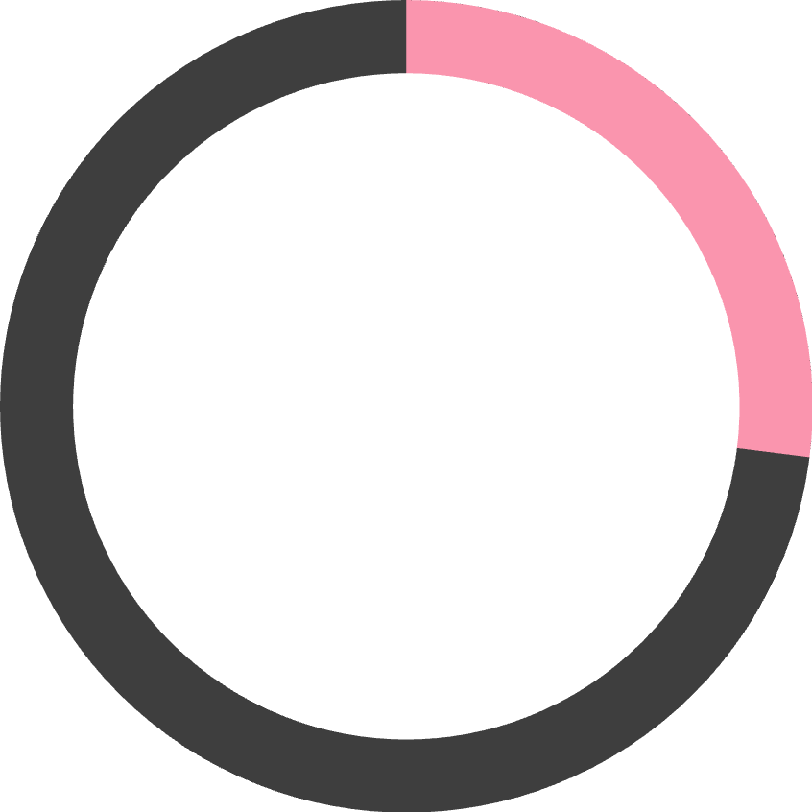

KEY METRICS
Customer Profile Snapshot
3.9K
$59.76
3.75
44
Total Customers
Avg Purchase
Avg Rating
Median Age
68%
27%
43%
Male Customers
Subscribers
Used Discounts

Slide 6
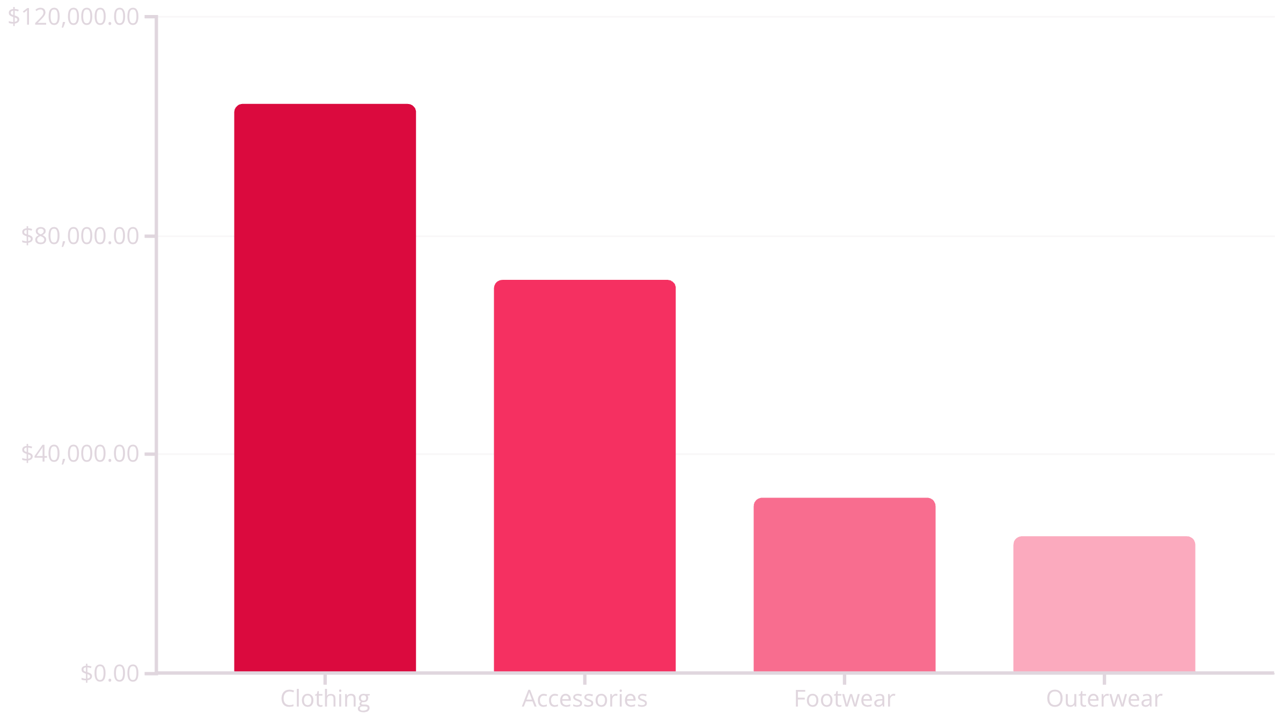
REVENUE INSIGHTS
Revenue Analysis
Gender Revenue Split
Top Revenue Age Group
Male: $157,890
Young Adult: $62,143
Female: $75,191
Followed by Middle-aged ($59,197)

Slide 7



CUSTOMER SEGMENTS
Customer Segmentation
New
1
83 customers
Returning
2
701 customers
Loyal
3
3,116 customers
Segmentation based on purchase history reveals 80% loyal customer base — a strong foundation for retention strategies

Slide 8


TOP PRODUCTS
Product Performance
Highest Rated Items
Most Discount-Dependent
Gloves (3.86)
Hat (50%)
Sandals (3.84)
Sneakers (49.66%)
Boots (3.82)
Coat (49.07%)
Hat (3.80)
Sweater (48.17%)
Skirt (3.78)
Pants (47.37%)
Key Finding: 839 customers used discounts but still spent above average — indicating discount effectiveness without sacrificing revenue

Slide 9
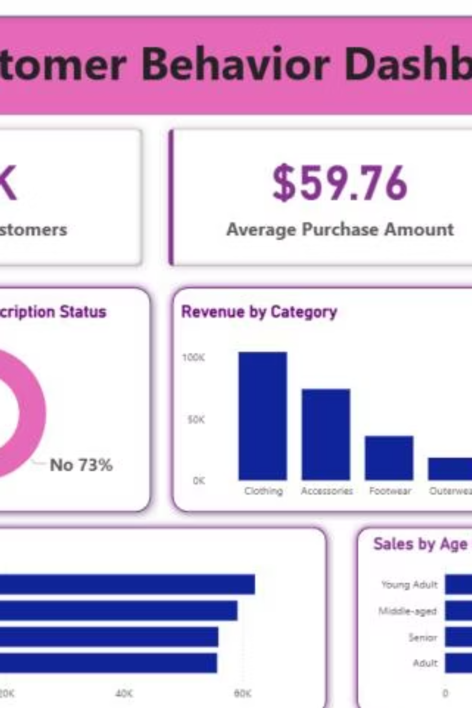
DASHBOARD
Power BI Dashboard
Interactive dashboard with filters for Subscription Status, Gender, Category, and Shipping Type
Real-Time Insights
Track customer behavior across multiple dimensions
Visual Analytics
Revenue, sales, and ratings by category and age group

Slide 10
RECOMMENDATIONS
Strategic Business Recommendations
Boost Subscriptions
Loyalty Programs
Review Discount Policy
Only 27% subscribed — promote exclusive benefits to convert the 73%
Reward repeat buyers to grow the 80% loyal segment
Balance sales boosts with margin control on high-discount items
Targeted Marketing
Product Positioning
Focus on high-revenue Young Adults and express-shipping users
Highlight top-rated items like Gloves and Sandals in campaigns

